Slide 1
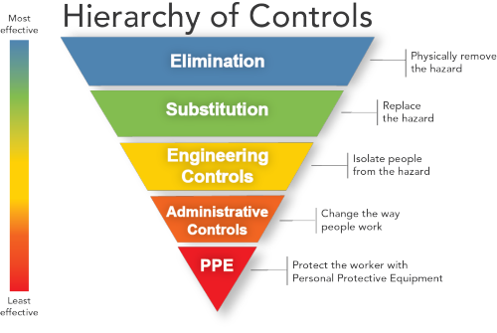
Personal Protective Equipment is your last line of defense.

